Slide 1

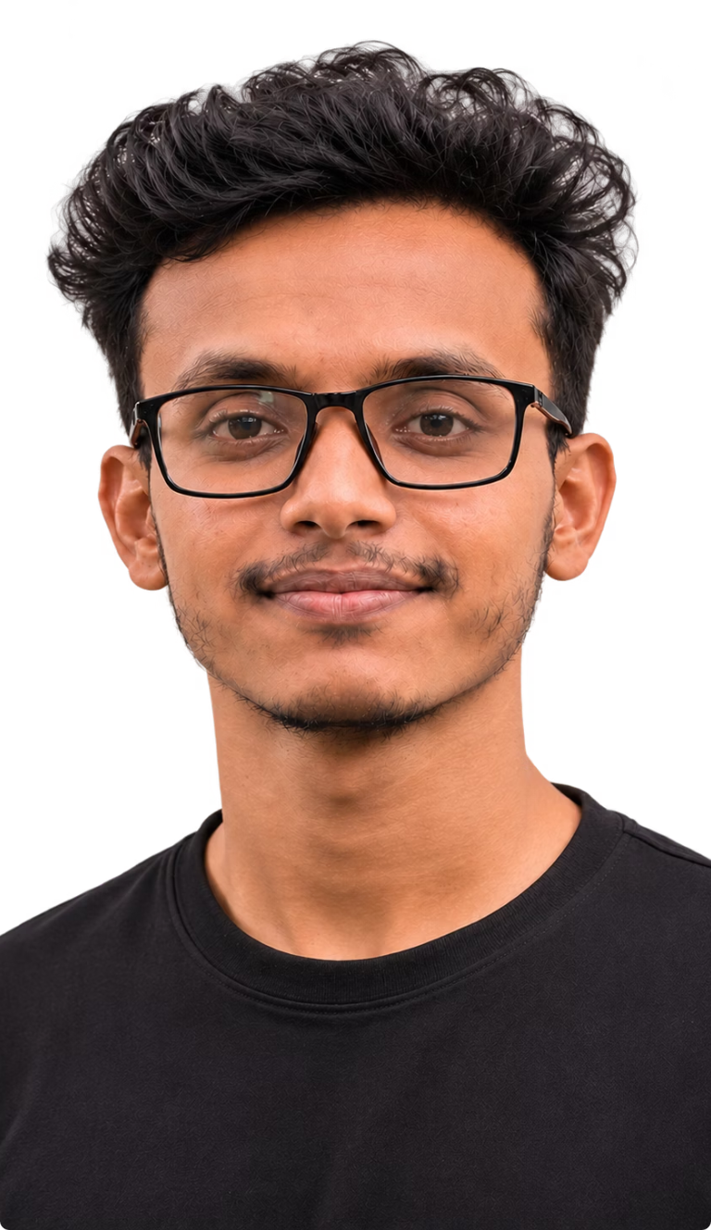


FROM IDENTITY TO AMBITION
BEYOND THE
THEORETICAL.
Learning. Building. Growing.
Rasel Shikder
BBA Student | Business & Technology Enthusiast
Sonargaon University, Dhaka, Bangladesh.
Notes:
A person is more than a classroom label. This is my story of learning, building, and growing across business and technology, while continuing my journey at Sonargaon University.

Slide 2




2
MY ACADEMIC JOURNEY
BACHELOR OF BUSINESS ADMINISTRATION (BBA).
Sonargaon University, Panthapath Campus.
Currently in 8th semester.
Academic interests:
MANAGEMENT INFORMATION SYSTEMS (MIS)
BUSINESS ADMINISTRATION
AUTOMATION & AGENTIC AI
MARKETING
AND BUSINESS-TECHNOLOGY INTEGRATION
Notes:
My BBA foundation connects several ways of thinking. Management, information systems, behaviour, marketing, and technology integration help me understand both how organizations work and how technology can improve them.

Slide 3






3
Experience: Telesales and Customer Service with CRM department.
2+ YEARS
OF LEARNING THROUGH PEOPLE.
Customer Relationship Management.
Inbound and Outbound Communication.
Customer Support & Complaint Resolution.
Professional experience developed my communication, patience, adaptability, and problem-solving abilities.
Sales Support and Order Processing.
After-Sales Service & Team Coordination.
Notes:
More than two years in telesales and customer service taught me the human side of business. Communication, patience, adaptability, and problem-solving became practical skills through real interactions with people.

Slide 4




MY TECHNICAL SIDE.
Full-Stack Web Development
Backend
Frontend
Node.js, Express.js, Prisma, Mongoose Nest.js
Databases
JavaScript, TypeScript, React, Next.js, Python
MongoDB, PostgreSQL, MySQL, Redis, Supabase
Versatile
Analytical
Builder

Slide 5
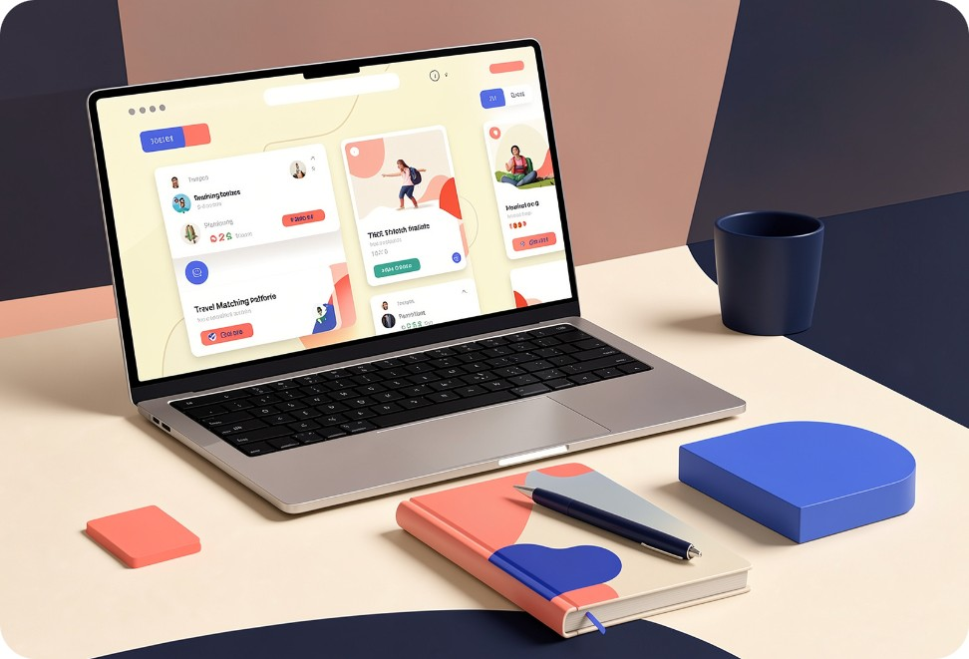

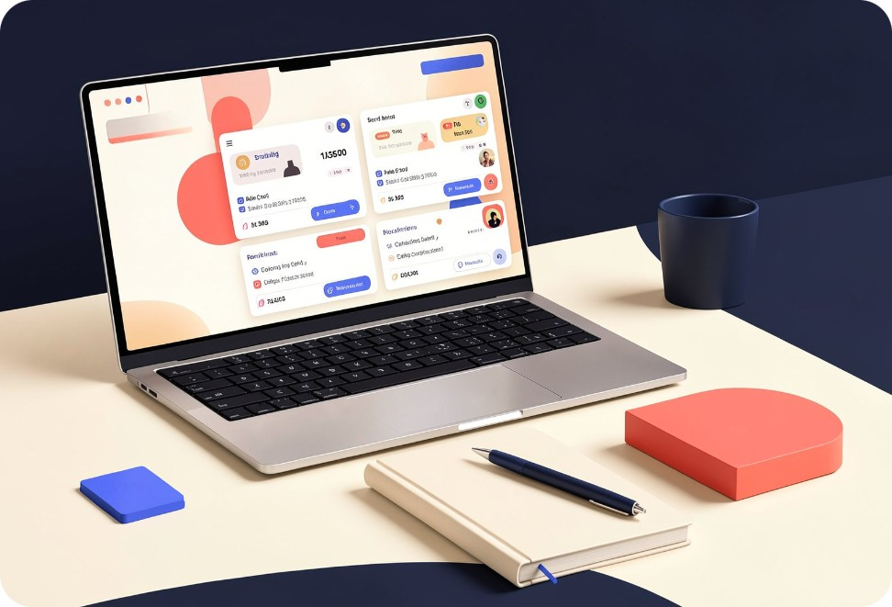
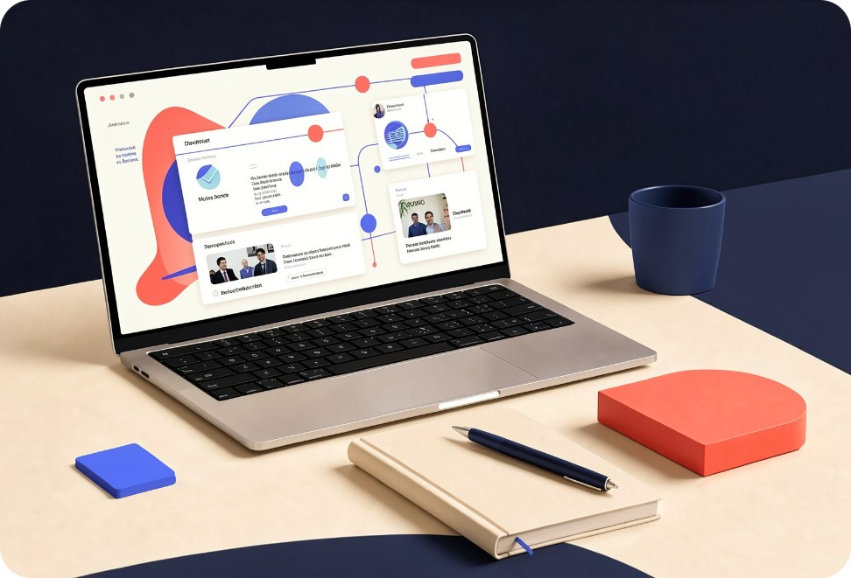

5
I LEARN BY BUILDING.
Previewer:
MatirPay:
Tough Tour:
Health teach:
Show yourself
without writing code
Managing digital
wallets and transaction
Tour management to make life easier
Automated schedule system for hospitals
ACHIEVEMENTS:
IELTS Academic — Band 6.5.
Programming Hero Next level Full-Stack Development Certificate.
Participators of Skills for Industry Competitiveness and Innovation Program (SICIP)

Slide 6





WHAT DEFINES ME?
PERSONAL OPERATING SYSTEM
CURIOUS
ADAPTABLE
Exploring new technologies and ideas.
Learning and adjusting to change.
AMBITIOUS
COLLABORATIVE
Committed to continuous improvement.
Valuing communication and teamwork.
BEYOND THE CLASSROOM
Personal interests
TECHNOLOGY EXPLORATION
PROBLEM-SOLVING
BUILDING PRACTICAL SOLUTIONS
INDEPENDENT LEARNING
BUSINESS AND TECHNOLOGY INTEGRATION
Notes:
These four qualities keep the journey sustainable. Curiosity starts the search, adaptability helps me respond to change, ambition keeps improvement moving, and collaboration reminds me that strong work grows through communication and teamwork.

Slide 7

THE JOURNEY IS JUST BEGINNING.
Complete my BBA.
Bridge business and technology.
Build meaningful technology products.
Ability to learn, adapt, and create determines how far I go.
Strengthen leadership and collaboration skills.
THANK YOU.
Continue academic and professional development.

